Slide 1
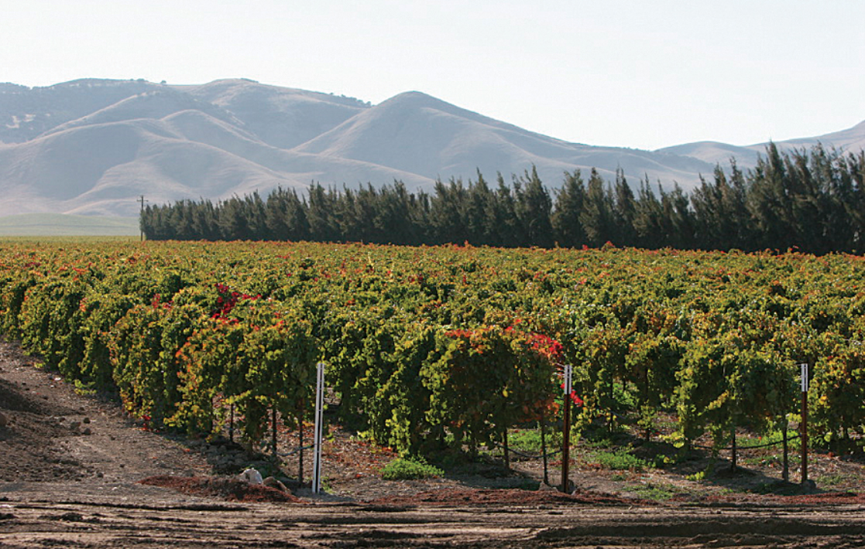
Agricultural-water use (AG) Package for gsflow
Hyper-resolution modeling of Regional water use by agriculture with integrated hydrology

Slide 2
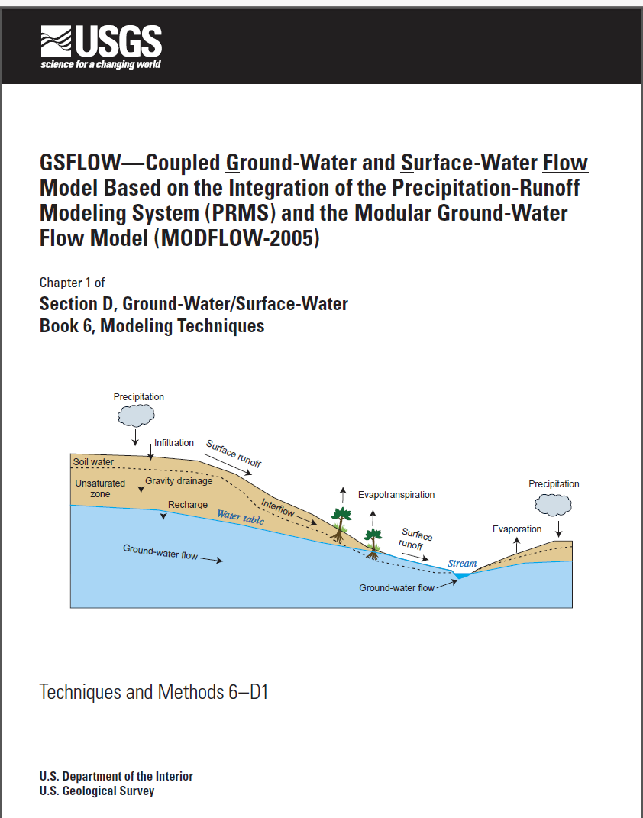
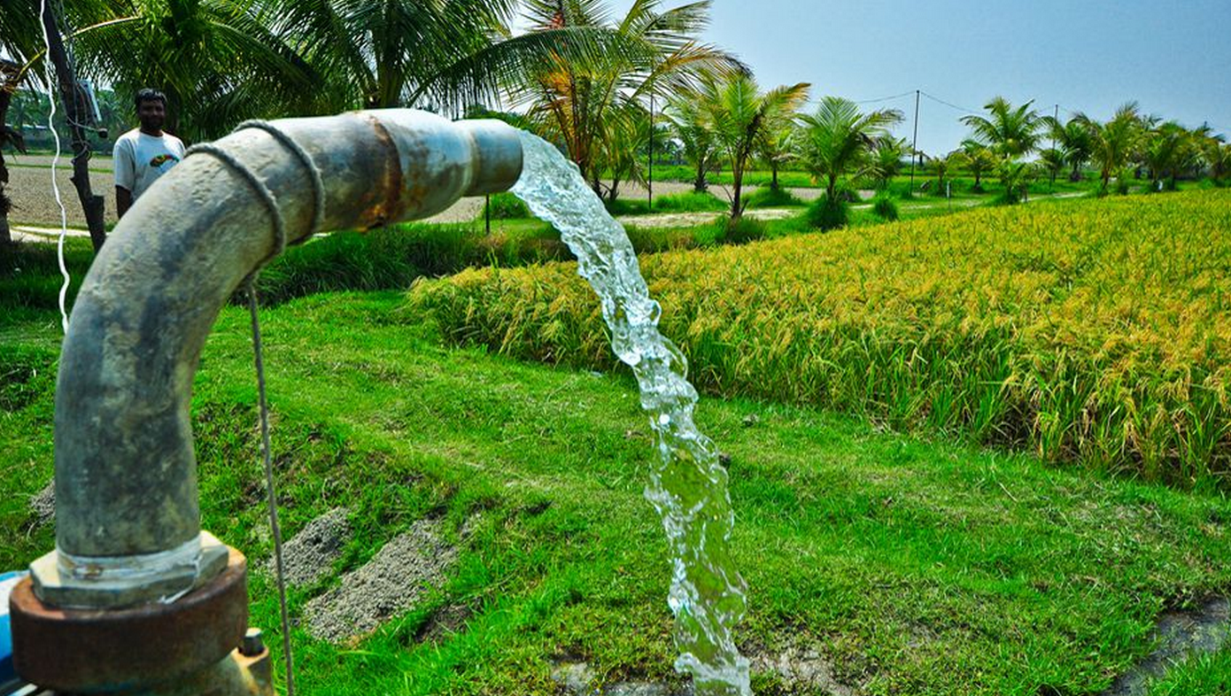
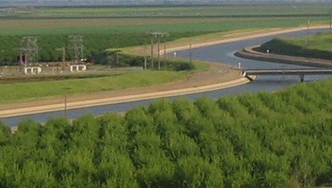
Agricultural-water use (AG) Package for gsflow
Need to represent agriculture in regional water resources assessments
Hydrology informs agricultural studies
GW
+
Conjunctive use
SW

Slide 3

Agricultural-water use—at the intersection of supply and demand
Demand estimated using land use, climate, and ET deficit
Hydrology model simulates water supply
Competition among different water sectors (ag., muni, res., indus.), or shifts in land use
Water Supply
Energy Demand

Slide 4
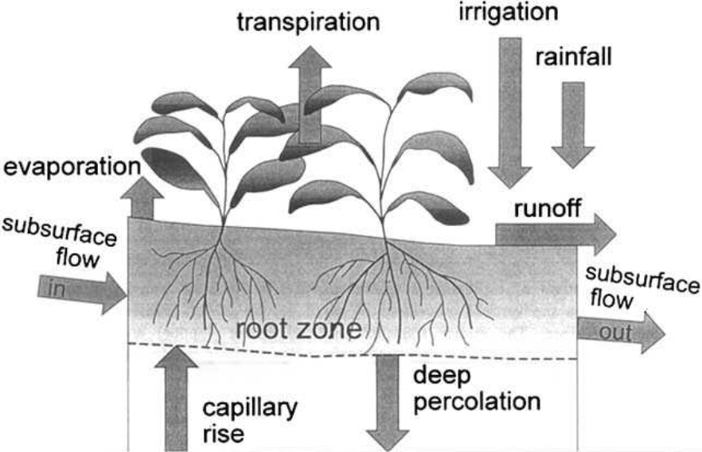
Energy and Soil-Water balance used to estimate NIWR
GSFLOW
Irrigation demand evolves in time due to climate and water supply
Irrigation demands are unique for each system and there are never good estimates of water use
Estimating irrigation demands with GSFLOW provides unique capability
--Irrigation processes happen automatically in GSFLOW/MODFLOW

Slide 5
Irrigation option 1 (simple)
ETww/ETa
Specify NIWR
Specified Irrigation demands
Water supply limits irrigation and GW can be used to automatically supplement SW
ET and return flows simulated using efficiency factors
Return flows routed
Divert SW
Pump GW
Apply irrigation efficiencies
Route return flows

Slide 6



solution for NIWR-option 2
ETww/ETa
Soil-water balance: actual ET (ETa) is a nonlinear function of NIWR, apply Newton’s method:
$${ET}_{a,i+1}= {ET}_{a,i}+\left[{∂ET}_{a,i}/∂{NIWR}_{i}\right]{∆NIWR}_{i+1}$$
${NIWR}_{i+1}= {NIWR}_{i}+\frac{{ET}_{a,i+1}−{ET}_{a,i}}{{∂ET}_{a,i}/∂{NIWR}_{i}}$
i=4
i=3
i=5
i=2
Irrigate farms
$∂ET/∂$Q
Energy/water budget
SW+GW
GSFLOW
i=1
Demand

Slide 7



solution for NIWR-option 3
Energy/water budget
Irrigation is “triggered” by field conditions:
$${{ET}_{a}}/{{ET}_{ww}}<{FCT}_{Trigger}$$
Calculate ${{ET}_{a}}/{{ET}_{ww}}$
Irrigation continues while:
Divert SW, pump GW
$$T_{irr}≤ T_{period}$$
Irrigation rate specified by user and can be supplemented by groundwater
Irrigate fields

Slide 8
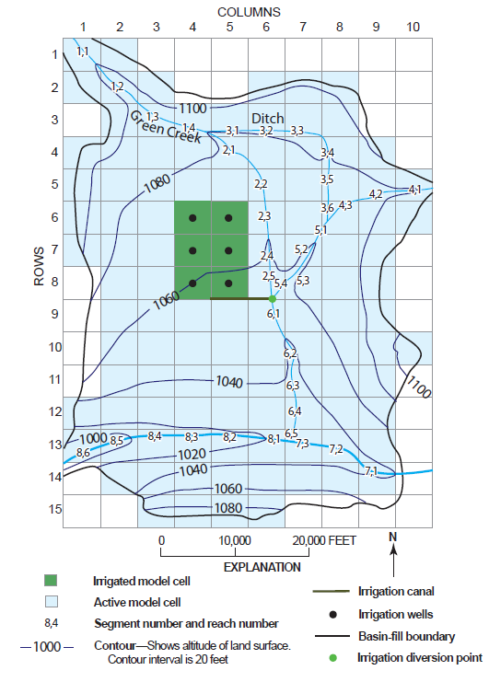
Example problem 1
MODFLOW-ONLY
Energy and water budget calculated by UZF Package
3,440 acres of irrigated fields

Slide 9
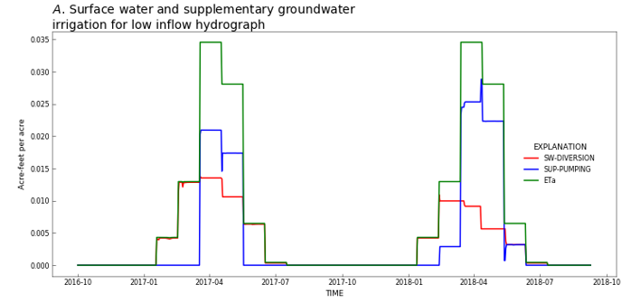
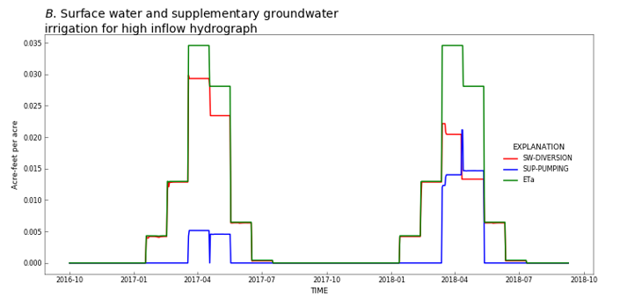
Conjunctive-USE of Surface water and groundwater
Dry climate
Moderate climate

Slide 10
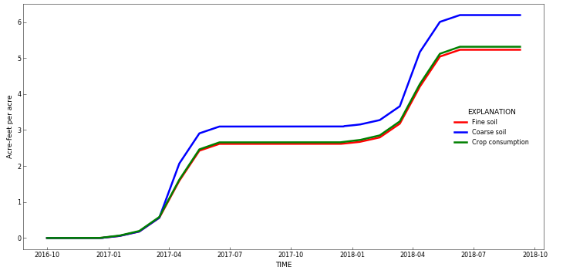
Impacts of field soil texture on NIWR
Coarse soils require more irrigation due to rapid percolation below root zone

Slide 11
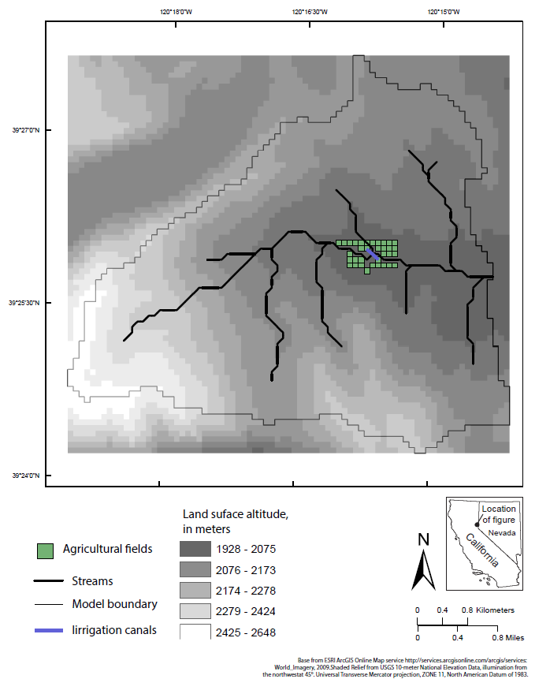
Example problem 2
GSFLOW
ENERGY AND SOIL-WATER BALANCE CALCULATED BY PRMS
27.5 hectares of irrigated fields

Slide 12
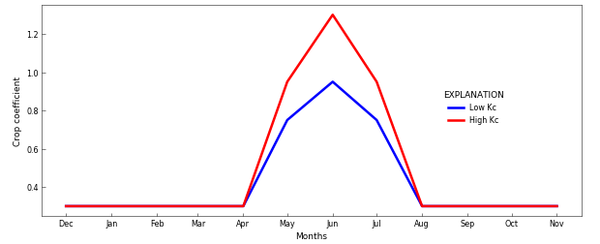
impacts of crop type (crop coefficient)

Slide 13
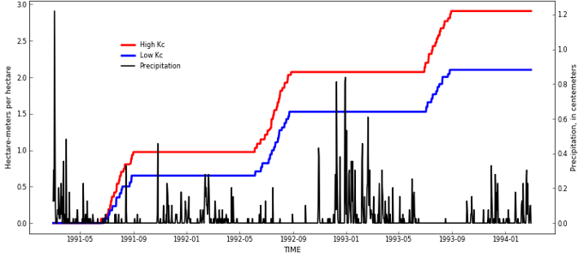
Irrigation amounts determined by minimizing ET deficit (Option 2)
Impacts of antecedent conditions on demand
Low annual irrigation
High annual irrigation
Low precipitation
High precipitation

Slide 14
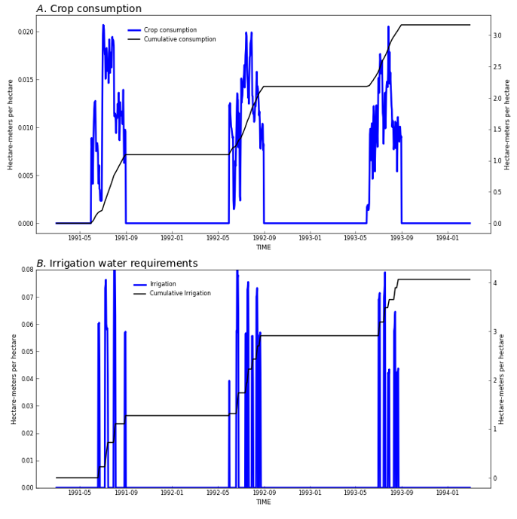
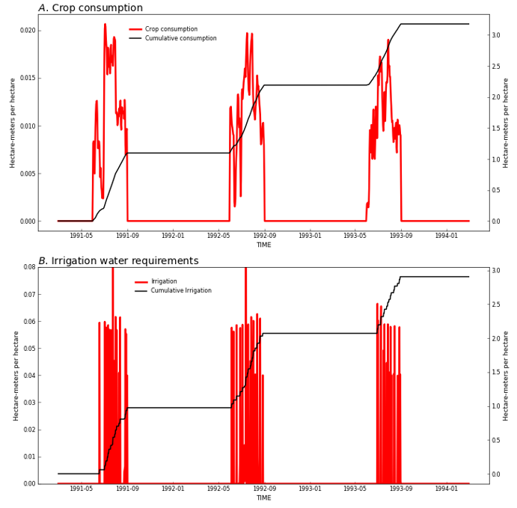
Differences in irrigation options
Trigger (Option 3)
ET Demand (option 2)

Slide 15
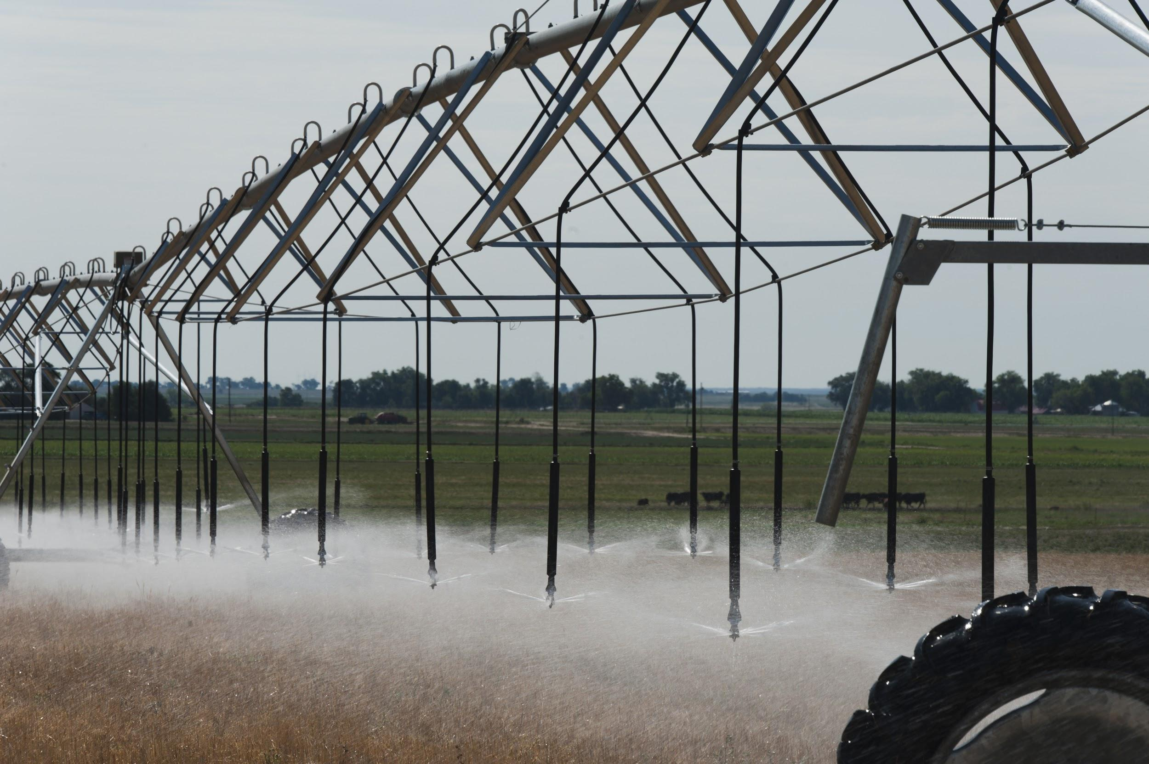
Summary
Automatically distributes water for irrigation using energy/water budget and mimics different types of grower behavior
Internal demand calculation for GSFLOW, considers evolving water supply conditions
Climate change impacts on agriculture, low flows, groundwater levels, and reservoirs available through GSFLOW
Facilitates integration with MODSIM (water-operations model) to represent prior appropriations

Slide 16
Thank you!

Slide 17
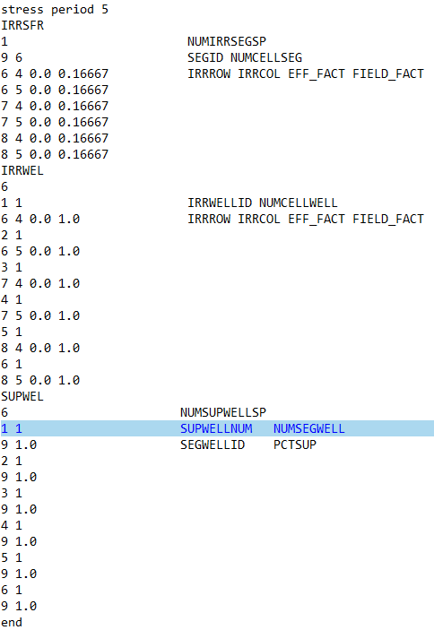
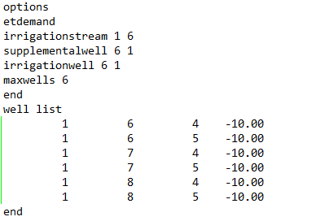
AG Package Input file structure (Key words)
Well list can use TABFILES to change max constraint on pumping

